Slide 1

ROYAL BONE (Double Tight Wishbone Offense)
TE
TE
Q
3
4
2

Slide 2
The Linemen need to have 2 things: Heart and Speed. This offense is very friendly to the linemen in the fact that it is easy to remember and there are not very many plays. The center needs to be the best all-around lineman,
followed by the tackles that need to be exceptionally fast.
The TEs need to have the capability of blocking every single down.
They will be needed to run pass routes if needed .
The Philosophy:
The double tight wishbone’s main concept is running the football every down to punish the defenders. With adjustments in blocking and running we can create situations that are unfavorable to the defense at all times. By having the mass of runners in the center it creates an unbalanced field of 8 verses 7 throughout the entire game. With 6 basic strong running plays backed by 8 weaker plays and 5 passing plays every game can be won.

Slide 3
The quarterback is 1, fullback is 4, tight ends are 7 and 6 running backs are 3 and 2.
Play Calling
.
Player and Gap Numbering:
The numbering system is extremely simple and easy to remember. The evens are to the right and the odds are to the left.
7 5 3 1 2 4 6 8
TE
TE
Q
3
4
2

Slide 4
Terminology of Plays:
There are two forms of terminology to use for the plays of the wishbone in
the huddle. The first type of calls is base calls and used against any defense.
The second type are adjustments set during game time that require
knowledge of what the defense is doing. These will set the offense on the
correct path and are great to use early so adjustments don’t have to be made
so late as half time.
Basic Calls:
Backfield
Base – Run the play normally
Dive – The FB carries the ball
Give – The RB carries the ball
Keep – The QB carries the ball
Inside – The ball carrier is wanted to go inside the base gap
Outside – The ball carrier is wanted to go outside the base gap
Option – Instead of running ISO we run option
Slant – The RB blocks the defensive end
Cover – The RB blocks first man coming at his man (option)

Slide 5
Option – The line blocks the same, but reach more
Inside – The linemen adjust to the defense
Outside – The linemen adjust to the defense
Secondary Calls:
Linemen
Gone – The center blocks up field, guards block down
Leave – The guard reaches up field
Clear – The tackle reaches up field
Empty – The guard and tackle reach up field
Lost- The play side guard pulls to wrong side (vs. 4-4)
Loop – Tackle blocks down, guard runs a SEAL
Combo – Guard scoops DT, tackle helps a second, goes to ILB
(Also be used for center and guard on a DT in A gap)
On – Tight end blocks man on him despite play
Arc – Tight end reaches up field (OLB on 4-4)
Crosser – Tight end blocks down, tackle blocks out
Smack – OT and TE block down, guard hits end
Linemen
Slant – The TE blocks down up field
(The way the OT and TE block will differ by play)

Slide 6
(Continued)
1. This is a “Gone” call. It is used mainly against the 6-1 defense or 8 man
fronts (10-1). The backside guard scoops hard and keeps that nose along the
LOS to run him into the play side nose guard, creating a harmless pile in the
middle. The center doesn’t have a great angle, but the middle linebacker
surprisingly won’t see him coming.
2. This is a “Leave” call. The center scoops hard, hoping to create another
pile like the “Gone” call.
3. This is a “Clear” call. The tackle leaves his man to go block up field.
“Empty” would be a combination of “Leave” and “Clear”.
4. This is “Smack” while running 44(45) Inside Give. The goal is to draw
the DT to the FB (who doesn’t have the ball). Look at the hole…
5. This is “Smack” while running 46(47). We’d do this to make a big hole
for the FB.
6. This is “On” call (I also have a “Gone” call made as well). This is used
during option plays where the TE would normally max down.
After-huddle Calls
Linemen
In – The player blocks inside
Out – The player blocks outside
Dog – The play should go outside the tight end
Tag – The guard and tackle double-team their man

Slide 7
Where to run?
On a play such as ‘Base 42’ the ball can either go to the outside or inside of
the strong side guard. This will be determined by where the defensive tackle
lines up. If she is in B gap the guard will call “OUT” meaning she will block
out and the play will run inside of her. If the defensive tackle is in the A
gap she will call “IN” meaning she will block inside and the play will go
outside of her. Against a 5 front the guard and tackle block the DT.
The first number will be the person who runs or has the ball and the second
number will be where we want that person to go. The only exceptions to
this system are the plays 44(43) . Who carries the ball is very
subject to change though. The way a play called is very simple and efficient
when the players have the offense down. Two examples would be:

Slide 8
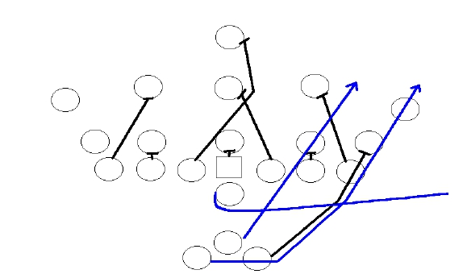
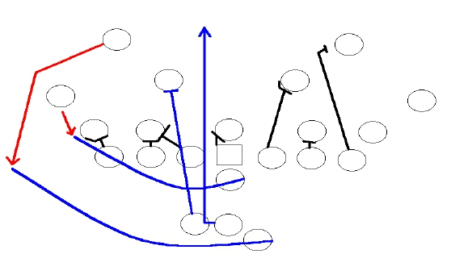
44 Outside Dive Slant
41 Dive

Slide 9

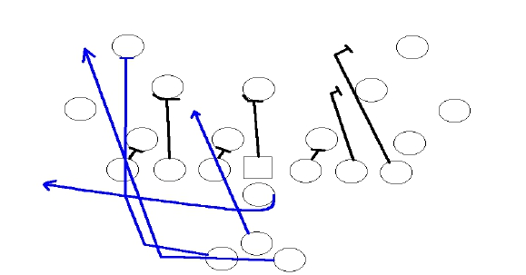
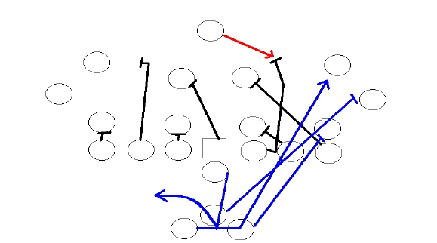
45 Outside Give
34 Loop

Slide 10
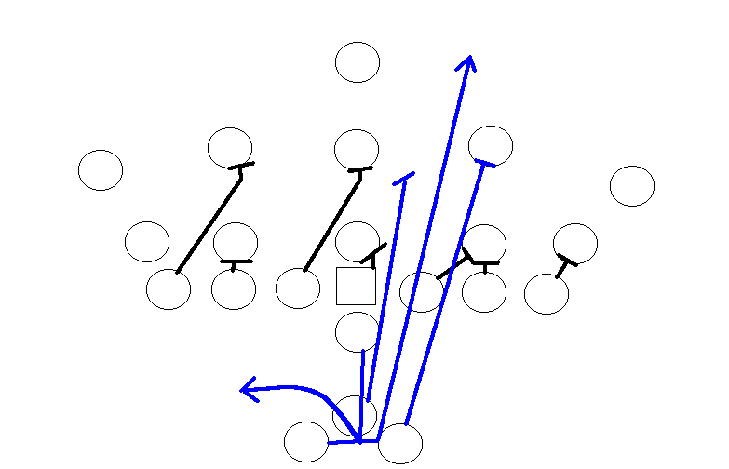
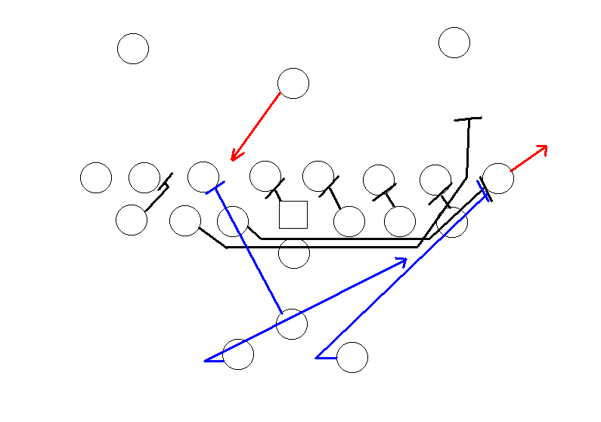
32 Inside
46(47) counter
Double-team that defensive end to drive him out of the way.

Slide 11
Strong Running Plays:
42(41)
This ISO play is a great play because when you delay the FB the Middle Linebacker also freezes as well. The FB should run at a little angle so the linebacker doesn’t have a good attack route on her. Against a 5 front the “OUT” call is made, but not against a 6 front… against that we will run
outside. The great thing about this is the ‘Option’ call that can be made after it.
The line still blocks the same and the corner and safety are forced to respect it.
The tight end should make an extra effort to scoop of course…

Slide 12
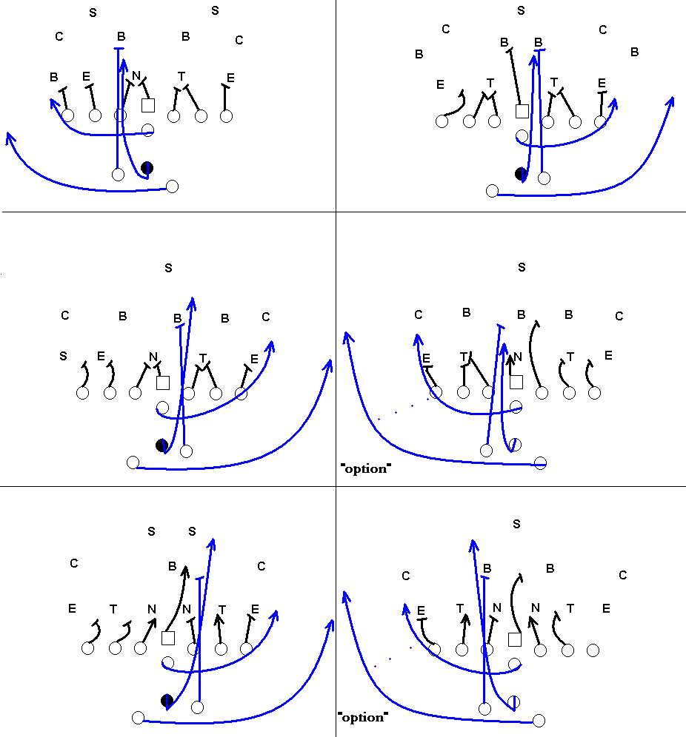

Slide 13
Strong Running Plays
34(23)
This is the base power ISO for the royal bone. There are two ways to running
the ISO… one would be the basic power, double team at the line, run right
over them kind… the other would be the less powerful but better when it
came to match ups in the box.
When you run double combo you do it
assuming the box will be stacked.
When you run the base you assume they
are easing up a bit in the secondary because your QB can pass the ball.
How many times do you think that corner will want to tackle the running back?

Slide 14
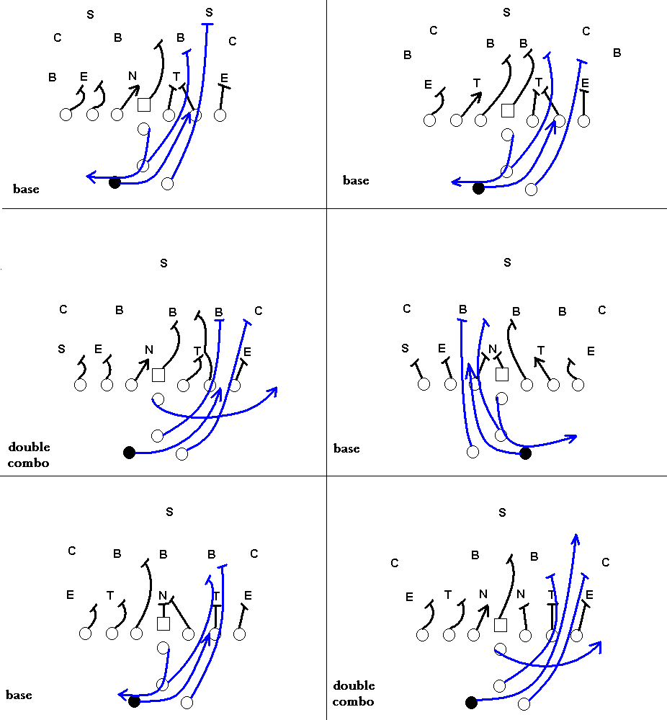

Slide 15
16(15)
Triple Option at it’s best. If the defensive tackles are trying to get up field to
disrupt the belly series then you run triple option and kill them with the
fullback dive.
Even if the defensive tackle takes the dive we can still run option efficiently even though most of the time they will be numerically equal to the number of players running the option.
The lead blocker reads the second option (first player outside the tight end) If she goes up field for the pitch the lead blocker bellies up field and destroys the corner.
Quarterback should see this and follow.

Slide 16
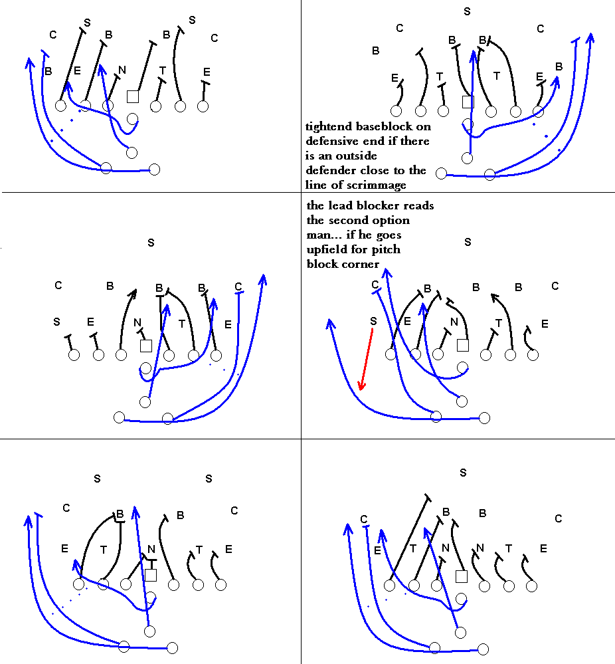

Slide 17
34(25)
This is a power off-tackle play. It is blocked just like 34(23) with the exception that the tight end will max down.
It looks a lot like the 34(23) as well if you look at it. With a “smack” call the guard can pull and block out on the end.
When “smack” is called the running back and fullback should block as if it were 34(25). If we are vs. the 4-4 the tight end should block out on the outside backer who’s close to the L.O.S.

Slide 18
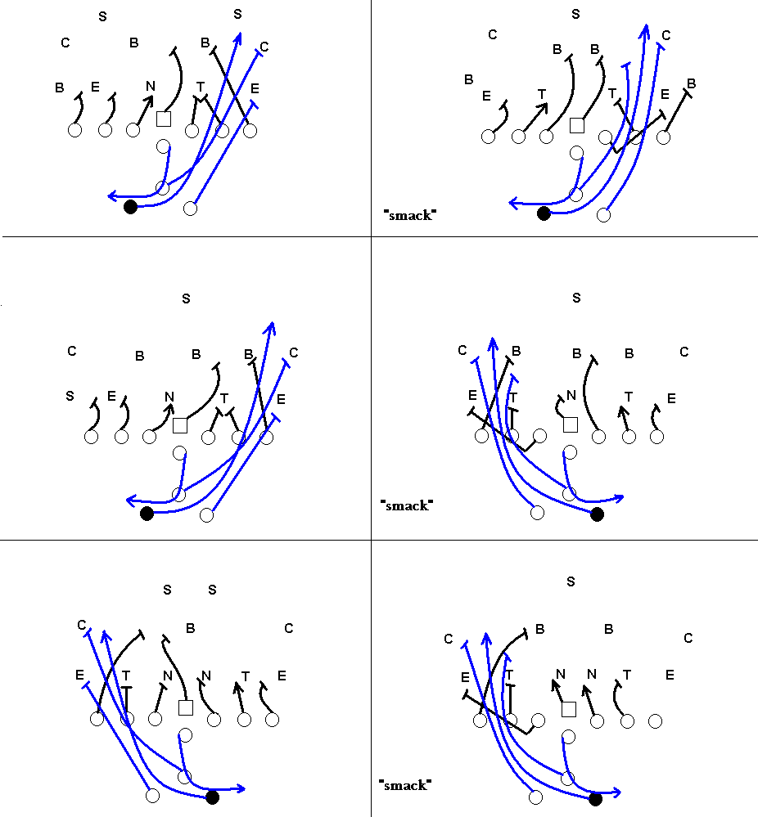

Slide 19
42(41)
It’s like 44(45) with the trap factor involved. If the DT closes very good (or too good) run a ‘Give’ or ‘Keep’ call.
The play side tackle and tight end’s block will vary depending if the call is ‘Dive’, ‘Give’, or ‘Keep’.
Against a 6 front a ‘Wedge’ call might be used to mean everyone scoops inside and the FB just tries to burrow his way for that one yard.

Slide 20
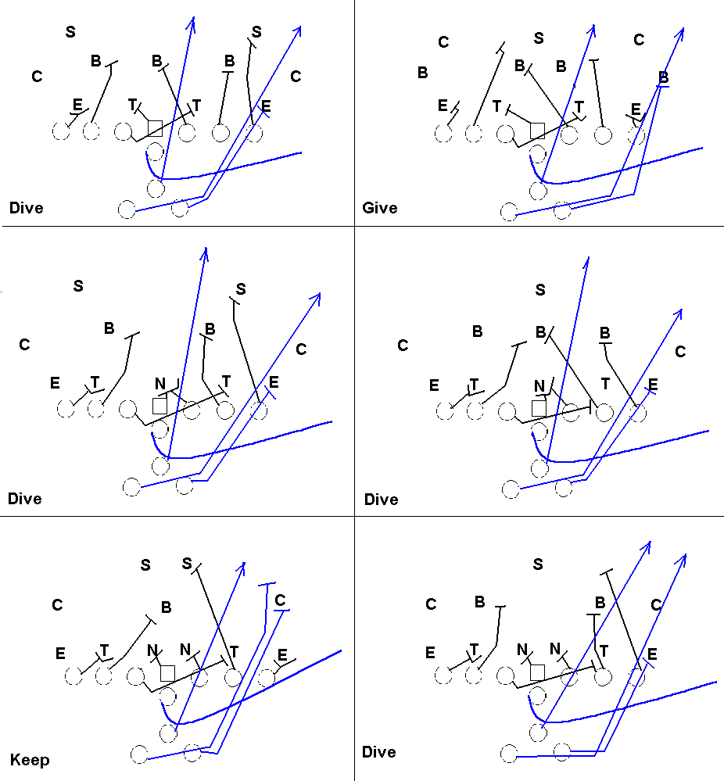

Slide 21
22(31)
This play is just straight out ISO. The blocking is the same as 42(43) but there is no FB delay factor so it’s not as good.
Run ‘Option’ if needed.

Slide 22
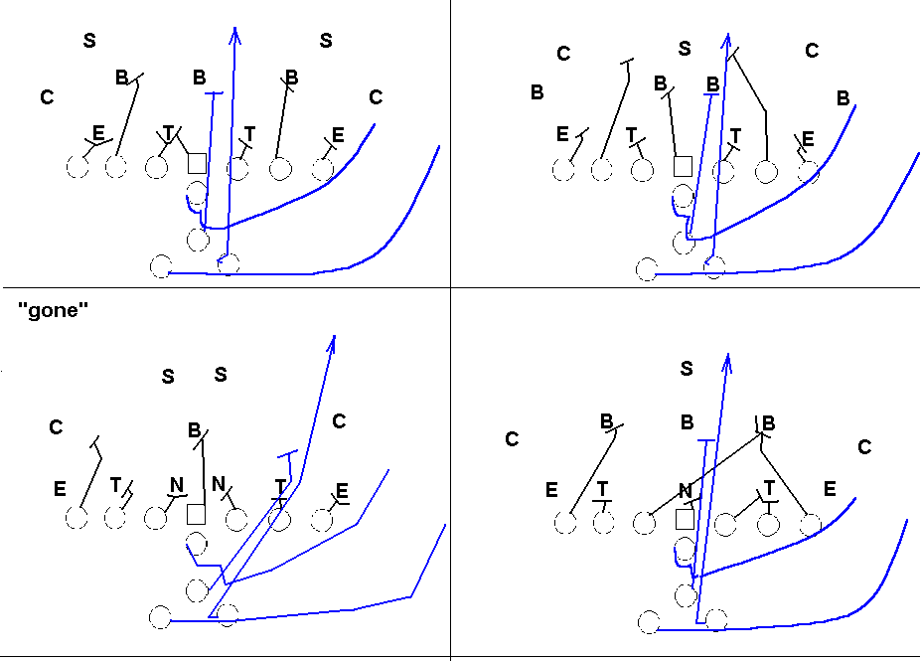

Slide 23
32(21)
This cross buck ISO is great against defenses with a MLB that read FB.

Slide 24
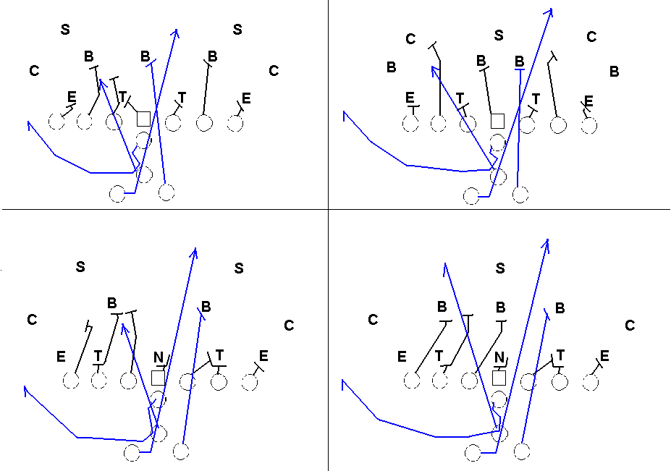

Slide 25
34(23)Counter
This counter play is great against the 5 or 6 front defense.
It requires a line that is somewhat fast and willing to run that far!
The guard kicks out the DE and the tackle runs a SEAL.
The FB picks up the loose defensive tackle, while drawing away the linebacker(s) at the same time.
Deception is a big key…

Slide 26
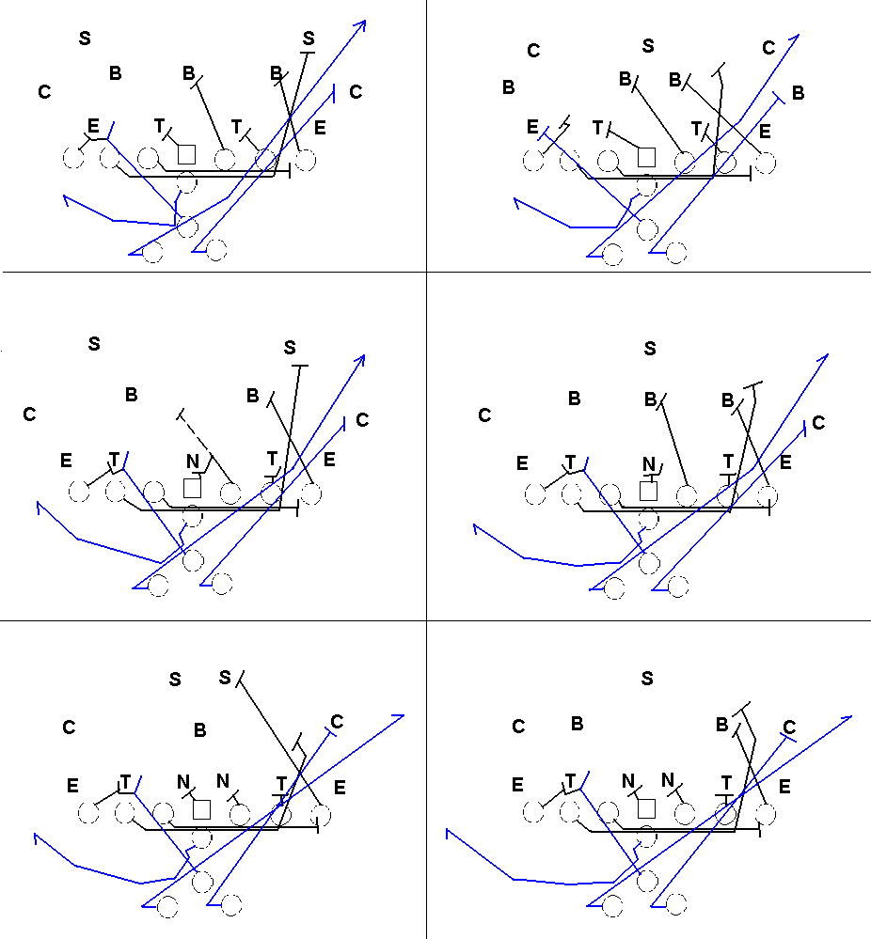

Slide 27
18(17)
This miss direction series is great against teams that rely on the FB to figure
where the play is going.
If their defense somehow flows with the FB then use this to throw them completely off-guard. The blocking is just about the
same as 44(43) and no matter the call (Dive, Option, Give, Keep, QB Curl) that blocking remains the same (except on QB Curl where the center blocks front side).
The hardest part is getting the linemen to remember that 18(17) doesn’t mean pull like in 28(37)… but you can also adjust your blocking to make it like that .

Slide 28
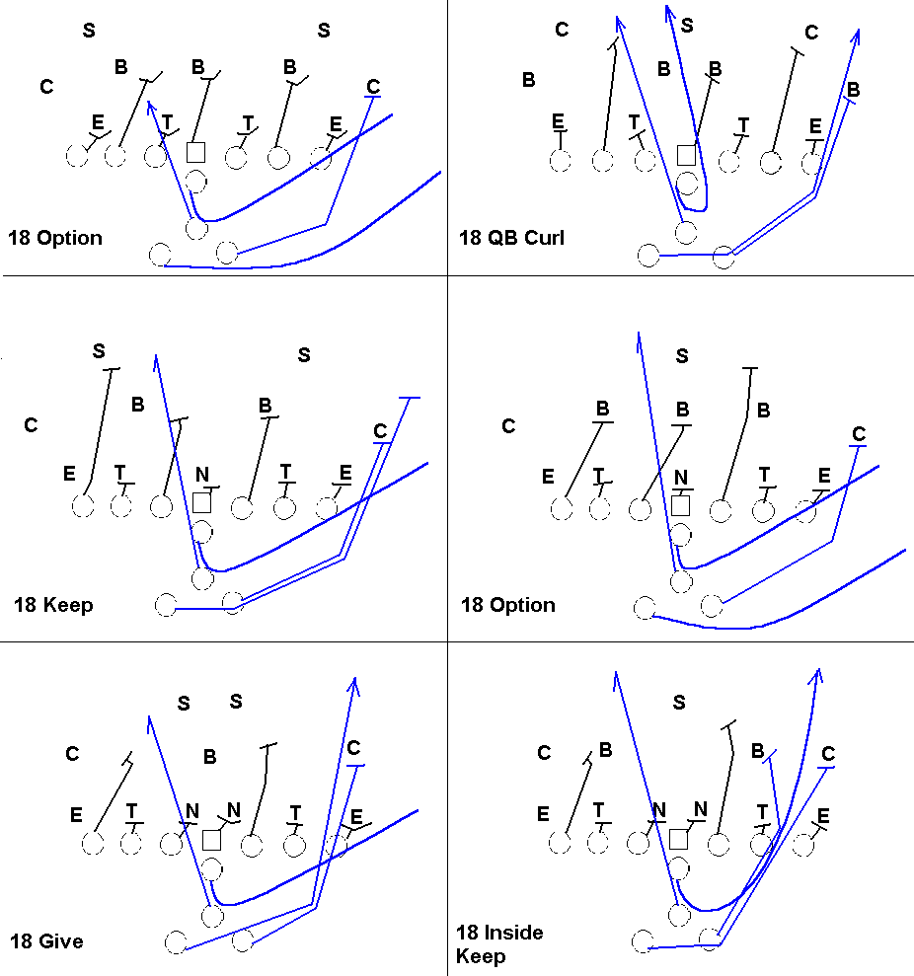

Slide 29
28(37)
The line DOES pull this time.
This sweep is also supposed to throw off the defense because you can run a ‘Toss’ or ‘Keep’ call to run a QB keep to the backside.
This way there are little-no backside defenders running the RB down.
This is very good against 6 fronts.

Slide 30
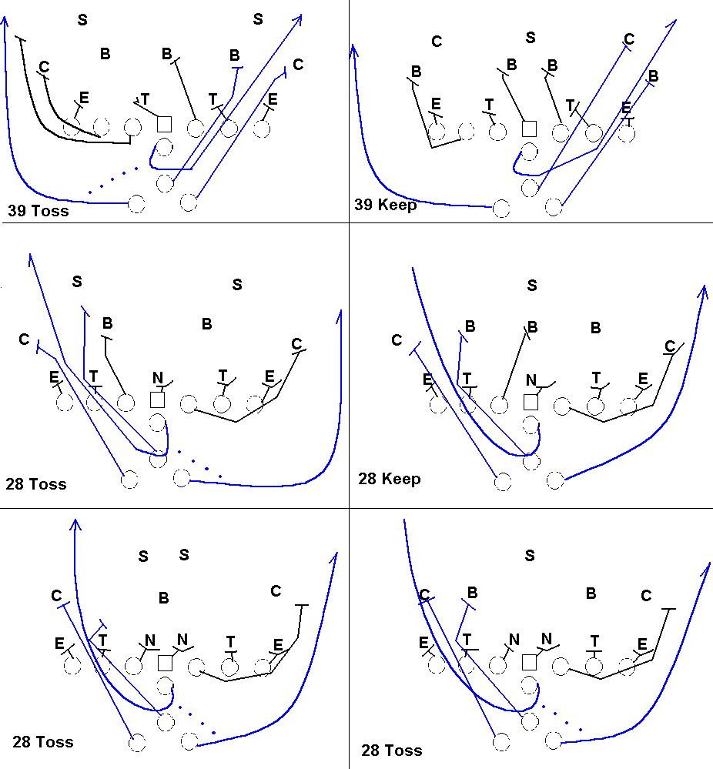

Slide 31
18(19) Sweep
This is a solid QB sweep play. It is basically a giant QB Iso with a guard support.
The blocking is very simple.
The tackle blocks the first player down, the guard pulls and hits the first thing inside… the fullback always has the corner (we want her to destroy the corner).

Slide 32
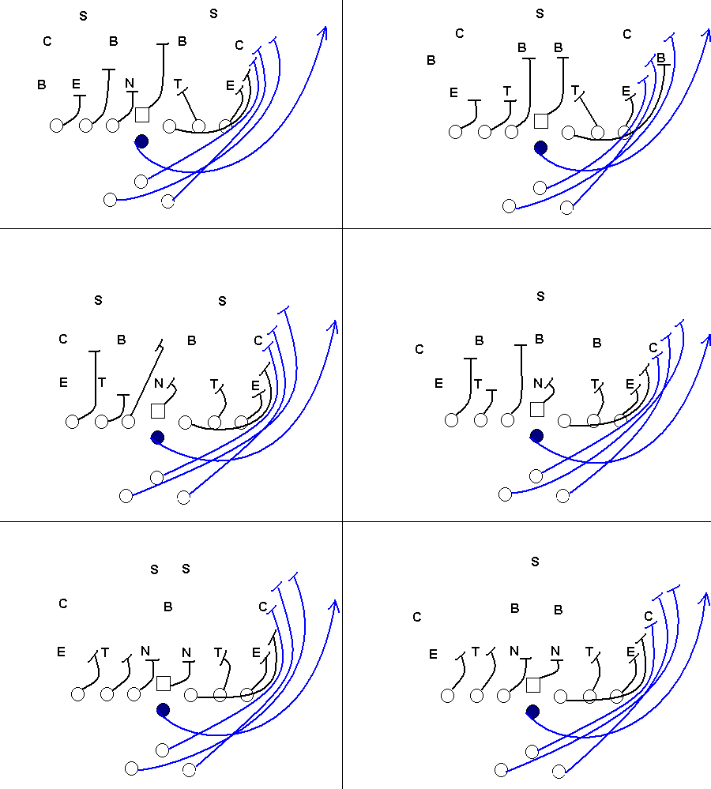

Slide 33
38(27) Power Sweep
If we just want to run them over (and if they are stacked in the middle) run this.
It is a quick little pitch from the QB so she can help block.

Slide 34
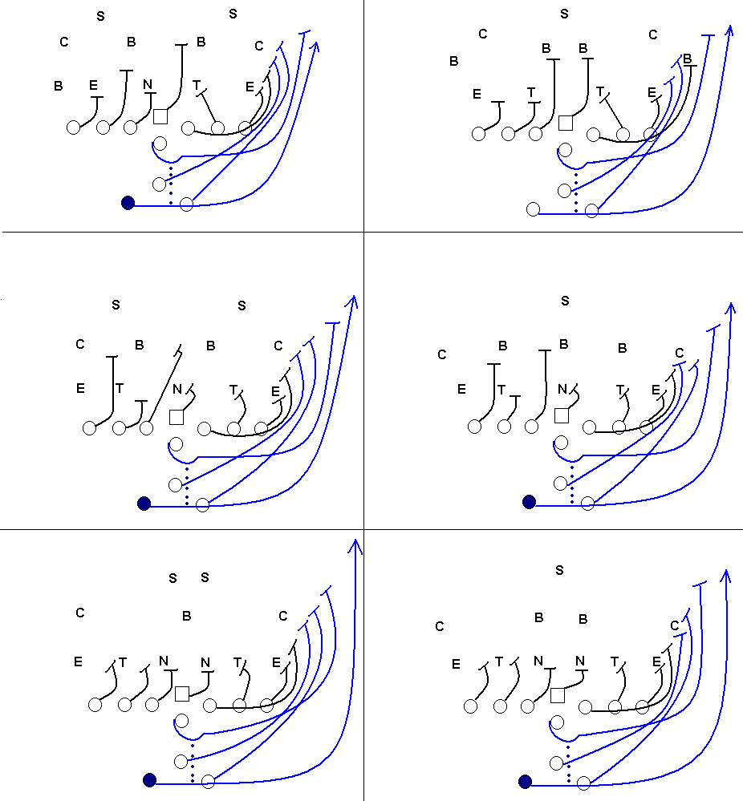

Slide 35
42(41) cutback
This is a fullback trap play with a twist. It’s called 42(41) cutback because
instead of a direct trap the fullback goes to the opposite side then he cuts
back into the hole.
This brings advantages because it gives the blockers more time to block the flowing linebackers and it gives the fullback a bigger hole to run through this way.
If the linebackers are flowing big time run this play.

Slide 36
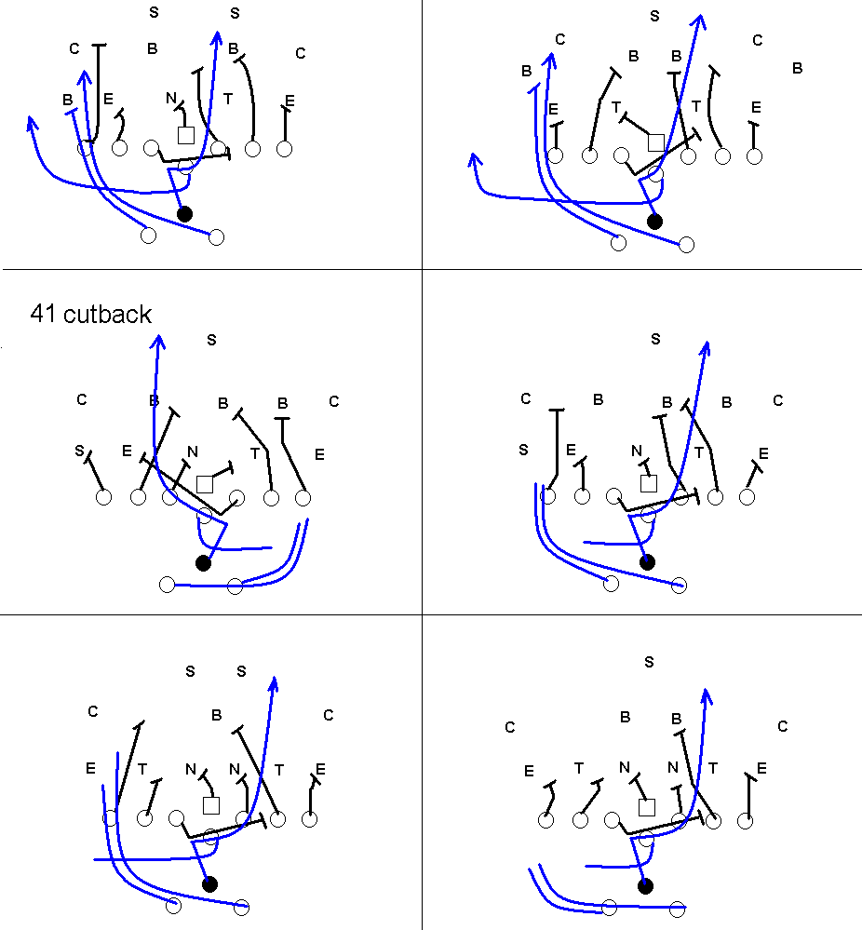

Slide 37
6 Base Pass Plays
Blue 34(25)
The most effective pass play of the wishbone is 34(25).
The Linebackers think that it is ISO so they fill the gap.
The QB should have around 3-4 options of who to throw it to.
Blue 34(25) Screen
The line scoops to the backside and then blocks up field. The trick is to fool
the backside into thinking that this is a 34(25) play and have them help
support it.

Slide 38
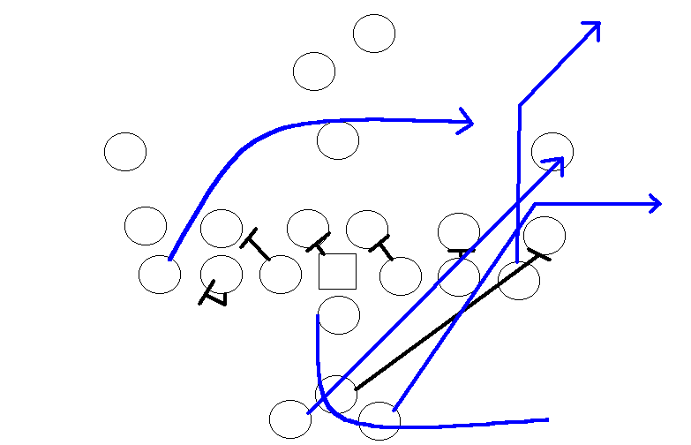
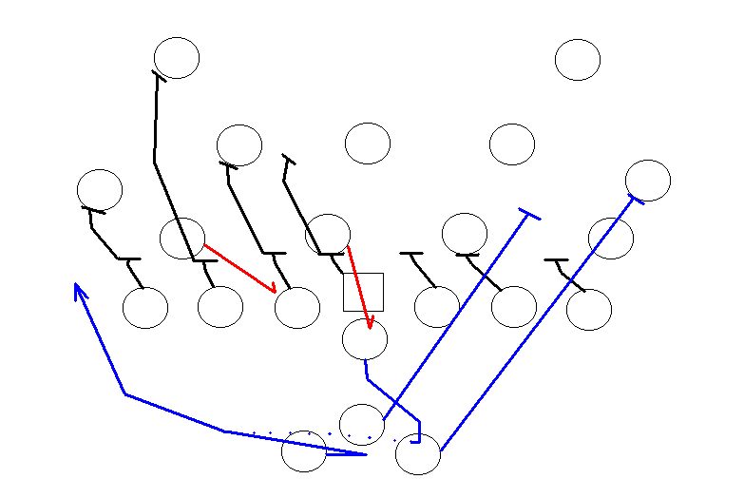

Slide 39
Blue 42(41)
This is a great trick play to use against defenses that have their corners playing basically a Cover 1.
We are looking for the throw back. The safety should be playing run support.
Blue 46(45)
This is a great goal-line play to use against defenses with corners that are playing close run support.
Having the tight end run a quick out catches them off-guard.

Slide 40
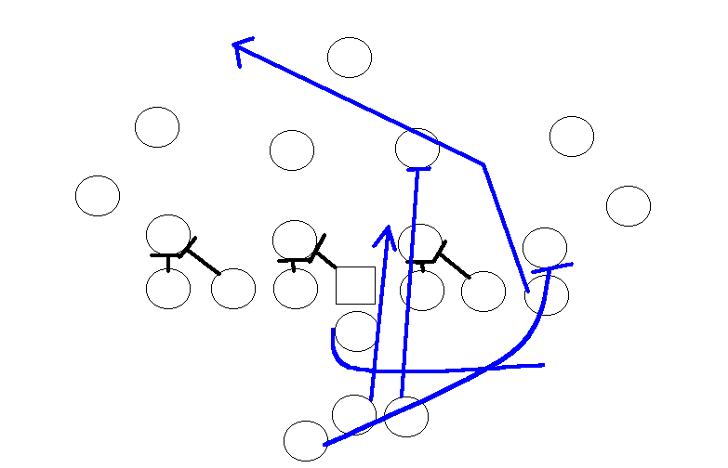
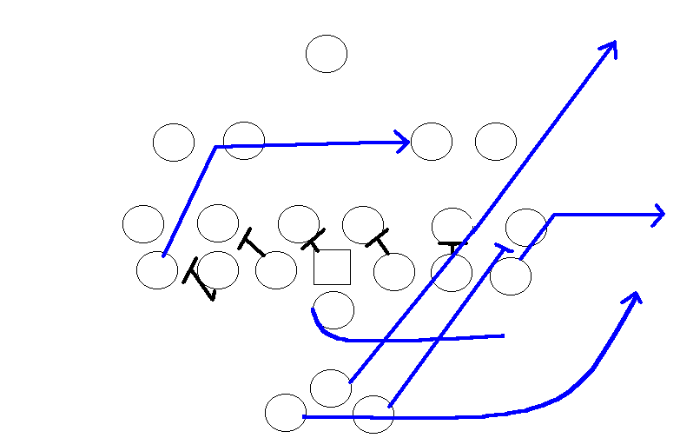

Slide 41
Tight-End pass plays
The tight end pass plays are a system of play-action passes where we send
the tight end a certain route while faking a 44(43) play.
The goal is to draw the defensive backfield to the LOS forgetting that there is actually a tight
end that they are assigned to cover.
This works great against teams stacking
the line with the corners.
The way these plays are called is very simple.
A ‘Right’ or ‘Left’ call is made to determine the direction of the fake 44(43) play. Even though it is not shown, the running back faking the ‘Give’ can go out to the flat just in case. After that the tight end’s number is called followed by the pass route.
The lineman-blocking scheme is very simple: block AWAY from the direction of the right or left call.

Slide 42
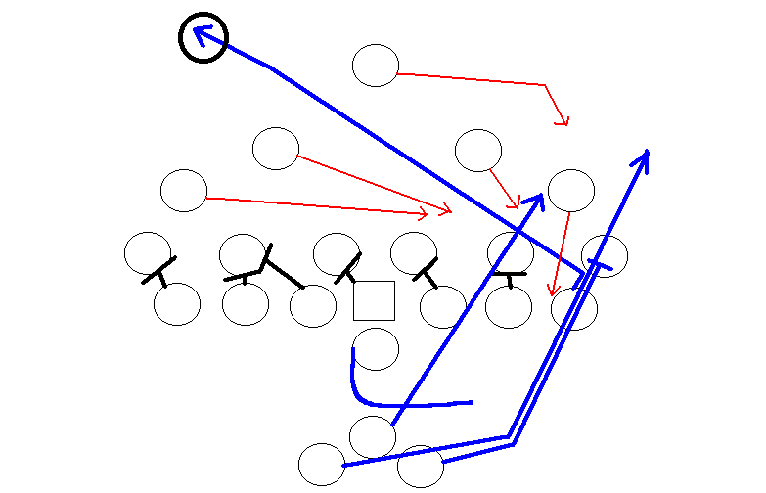
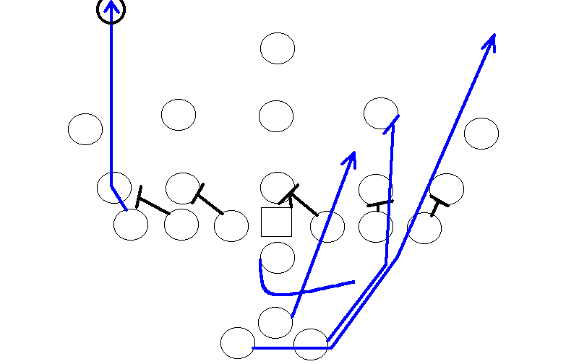
Right 62
Right 79

Slide 43
Against the Stacked Fronts:
The 8-man front is a Goal line defense that relies on the defensive lineman’s ability to control his gap.
The linebackers are lined up just inside the tight end and are suppose to jam her
(slow her down so the stud MLB can mop up).
This defense is terrible against the option because there is no one reading the QB.
This defense is also weak against the double tight wishbone because splits can be widened on either side and the defense won’t be able to know which side the play will go to.
This is why the ROYAL BONE is so great.

Slide 44
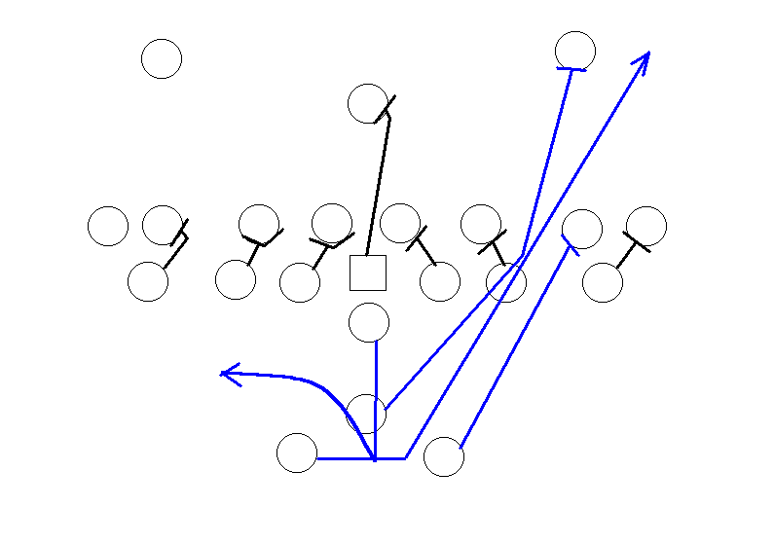
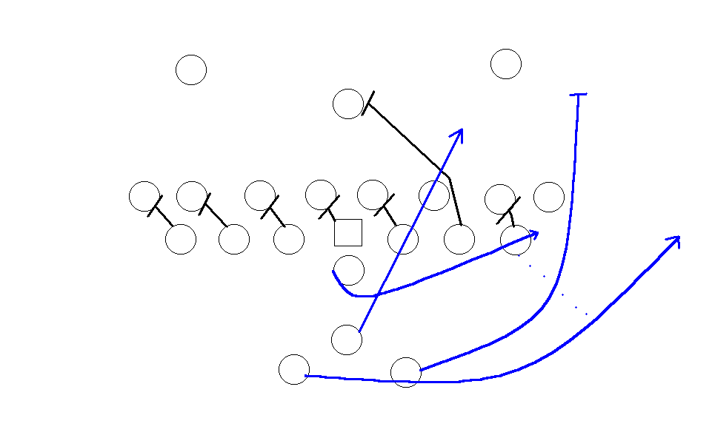
34(23)
16(17)

Slide 45
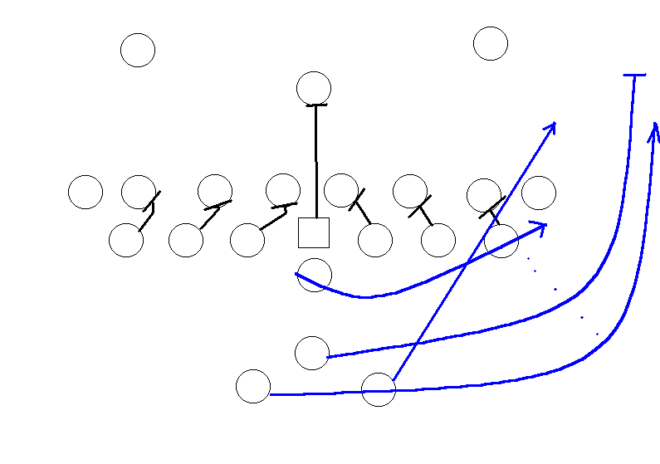
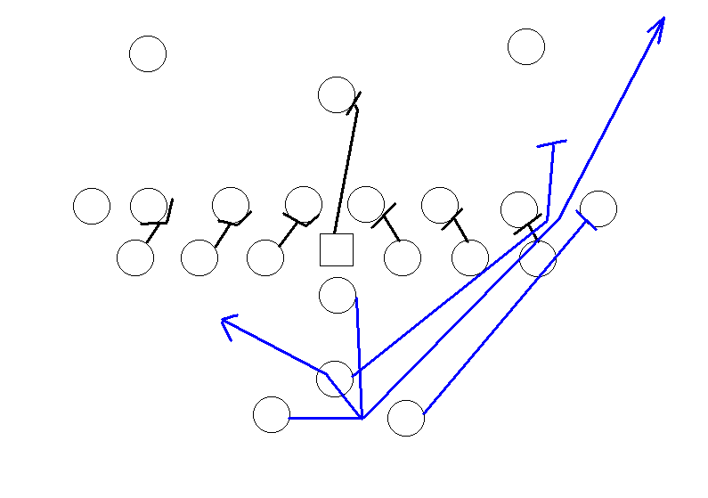
38(27) or 46(45)
option
36(25)

Slide 46
Against Double Safeties
What I mean by “double safeties” is that the teams you play move their two
safeties inside to read the two running backs.
There are a number of ways to
beat these kinds of defenses. On paper they can be seen as trick plays… but
in reality they are just exploiting the weaknesses.
Remember that they have to
change their defense to adjust to ours;
they are automatically at a
disadvantage.
Giving a play a call can change it significantly enough to beat
these kinds of defenses.
These 3 plays are the strongest.

Slide 47
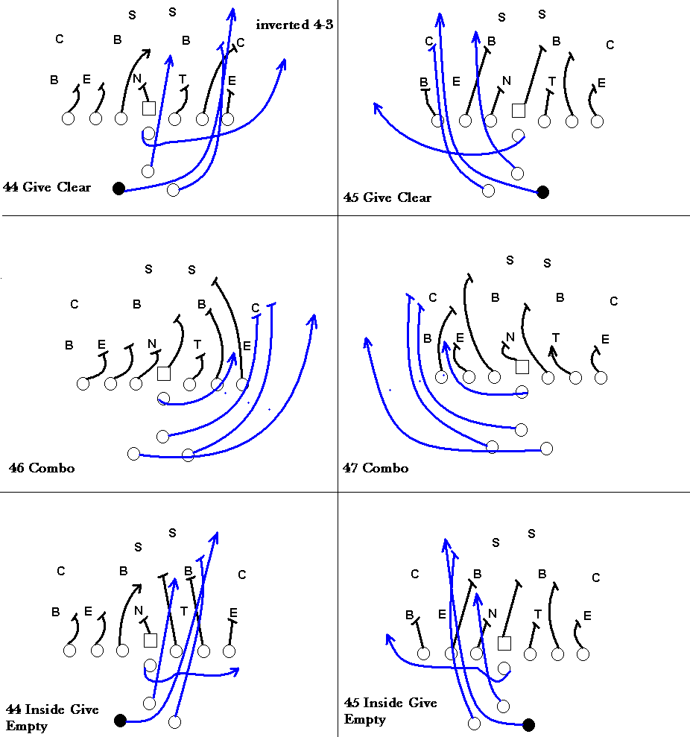

Slide 48
SPECIAL NOTE
If the DT doesn’t go for the FB run 44 Dive Empty or 16(15) Option.
In this adjusted 5-2 the linebackers read the FB and flow to the play side
gaps.
This is the key in beating this kind of defense. The nose will try and
read the center but as we all know this doesn’t work to well come game
time.
When the fullback gets in their backfield and their safeties are forced to take her, run Give and Keep all night.

Slide 49
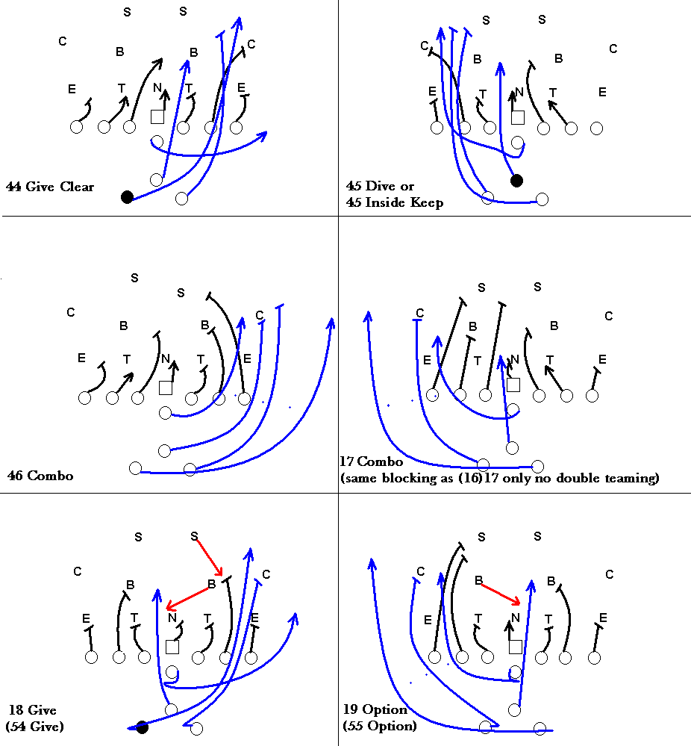

Slide 50
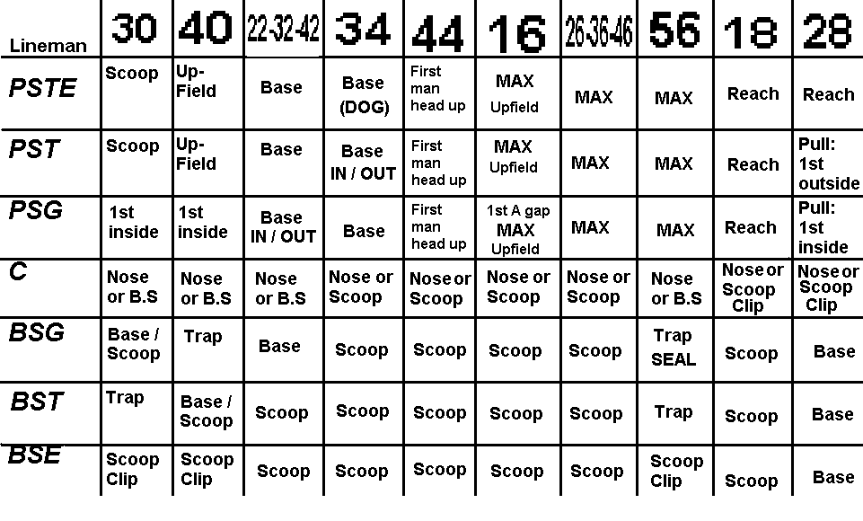
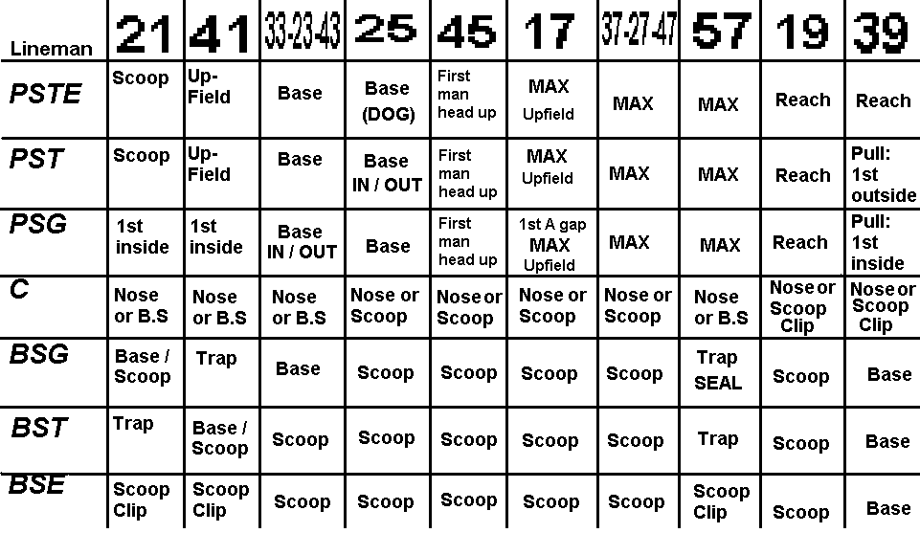
Lineman Blocking Scheme
The double-tight end wishbone offense is very lineman friendly. Here is an
outline of each of the lineman’s blocking responsibilities on the right side.

Slide 51
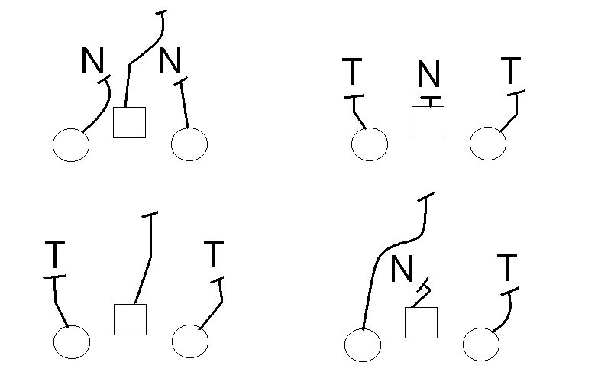
The blocking of the center and guards are assumed… if there are two inside
shades as defensive tackles the backside guard reaches (or cuts) the player inside him while the center goes for the linebacker. If the center has a defender
over her she will base her. If the nose guard is in-between the guard and
center she will be blocked by the lineman she is closest to. If she is in the
middle the guard will reach her if she can… if she can’t make this very
difficult block this should be communicated.

Slide 52
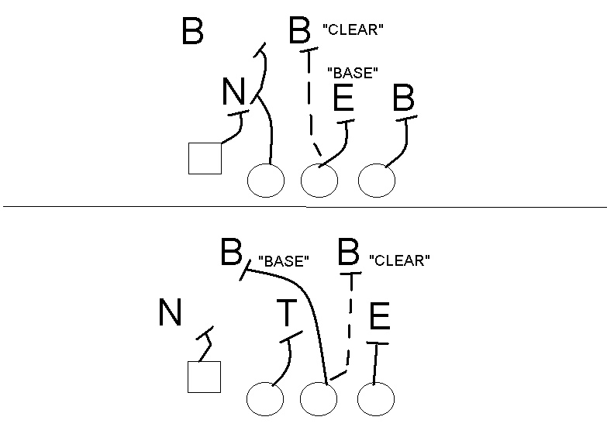
This part is very simple… but the tackles have it difficult in some aspects.
Depending on our patience we can either have the tackles block the first
defender off the line of scrimmage inside or we can have her block the first
man ahead of her .
When the tackle blocks the first inside it can cut off any defensive flow that
the defense is running.
In most cases this means that the tackle will be after
the inside linebacker… if the tackle can get to her before the linebacker fills the gap you can run dive all night long. If this is not working you can call “clear” and have that tackle block straight up field.

Slide 53
Notes on Passing Plays
The only thing the linemen need to know is that they can’t go up field, they
need to block away from the last number (on Blue 42 they block left and on
Blue 45 they block right), and they need to hit something on the line of
scrimmage. They can’t give the defensive backfield the notion that we are
trying to pass so they find someone as quick as they can or if they detect
blitz pick that guy up. Splits should be a little bit closer than normal.
Final Notes
Deception and Power are the key elements in the wishbone. If any member
of the defense is not sold on the fact that a certain person has the ball this
offense can fail. 34(23) is undoubtedly the most obvious play in this
playbook as to has the ball. Defensive coordinators will scheme and figure
innovative new ways to try and beat the wishbone and the line of scrimmage
will be crowded in most of your games. What needs to happen is that we
have to work on the option and deception factor of the wishbone. A team
cannot prepare for an offense like this in 4 days. Find the cracks in their
defense (and there are always cracks and weaknesses), we will watch
their defense and see what the scheme is, adjust to what they do and kick ASS!

